Slide 1


Workflow | Just-in-Time Rationalization | The process to rationalize workload to available resources in order to minimize multitasking, oversubscription, and ambiguity.
Tools to Simplify, Engage, and Learn | Ruthless Rationalization | The workflow that forces work to fit within the capability of the team by some combination of reducing the goal, increasing the resources, or selecting more valuable projects.
 | Kanban Board | Visual rationalization for irregular tasks arrived at by consensus between the knowledge staff and the internal customers.
 | Kamishibai Board | Visual rationalization for regular tasks arrived at by consensus between the knowledge staff and the internal customers.

Slide 2
Rich stops by desk for 15 minute status update on China web site
Put out code with possible solution to John’s critical bug
Miss critical requirement to link to regional ecomm
Merix Inc. failed compliance test. Needs review immediately
Kim called
at noon—10 minutes arguing b/c work not
done yet
Start work Kim needs today for print ad
Phone call from John—critical bug
H idden Errors
I nformation Friction
I nferior Problem Solve
M ore is Better Thinking
H idden Errors
D iscord
8:00 AM
9:00 AM
10:00 AM
11:00 AM
12:00 AM

Slide 3

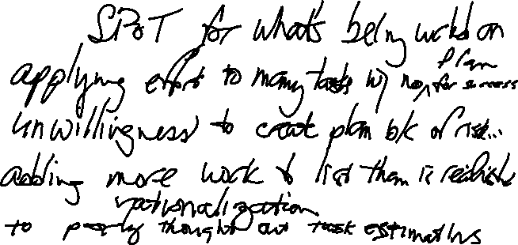
D
iscord
Conflict when one person needs work but it’s not another person’s priority
I
nformation Friction
No single point of truth for tasks being worked on vs. what’s coming vs what won’t.
M
ore-is-Better Thinking
Applying effort for more tasks than can be done with no plan for success
I
nertia to Change
Unwillingness to define success for fear that reducing work backlog will reduce performance
N
o-Win Contests
Demanding commitment for workload that is unrealistic.
I
nferior Problem Solving
No time set aside for diligently defining problems and testing counter measures
S
olution Blindness
Keep working on projects once they are in queue. No systematic way to reprioritize.
H
idden Errors
Important tasks without resources can get lost in unrationalized work.

Slide 4
Ready?
Set Value goal
Reduce goal
Estimate effort to achieve goal
Increase resources
Identify Set of Work
Increase value of
work
Go
Rationalized to resources?

Slide 5
Committed to in Q1
Not committed to
Have to do
Task A
Priority 1
Task E
Priority 4
Task C
Task B
Task A
Priority 1
☑
☒
Task D
Priority 2
Task C
Priority 6
Task D
Priority 2
☑
☒
Task A
Prioritize for Q1
Task B
Priority 3
Rationalize for Q1
Task B
Priority 3
☑
Task E
Priority 4
Task F
Priority 5
☑
Task F
Priority 5
Task D
Task F
Task C
Priority 6
Task E
Want
to do
Step 1:
Unordered task list
Step 2:
Prioritize
Step 3:
Rationalize

Slide 6
Upstream Signal
Measure
See the Pepperoni slices are nearly gone
2. Signal
Request pepperoni pizza from kitchen.
Pizza Prep Table
Pizza Buffet
3. Produce
Prepare and bake pizza.
Tomato
Pepperoni
Onion
Veggie
Sausage
Pizza Oven
4. Fulfill
Take pizza to the buffet.
Downstream Flow

Slide 7
Pushing decisions creates waste.
Let the need for action pull the decision.
Time between “decide” and “act” is lost opportunity to learn.
Backlog
Next Up
In Progress
Confirm/Wait
Done
3
3
Create global on-boarding template
Open Shared Dir. For Red House
Run security check—EU, Mid East, Africa
Standard-ize pricing module for Americas
Run security check--Americas
Customize Website for Red House team.
Connect MRP to China team products
Specify displays for SE Asia office
3
Deploy password storage appl globally
3
Customize Website for Widgets, Inc.
Hire brochure design consultant
Support 8k in SE Asia Office
Select HD Printer for Berlin Office
Install compliance module 7RRL
Open port to connect to Widgets, Inc
Install Global Drivers for Conf. Rm Cameras
Initial brochure design
3
3
Install compliance module 4A4S
Run security check--Asia
Stop
=>3
Stop
=>3
Upstream Signals
Downstream Flow

Slide 8
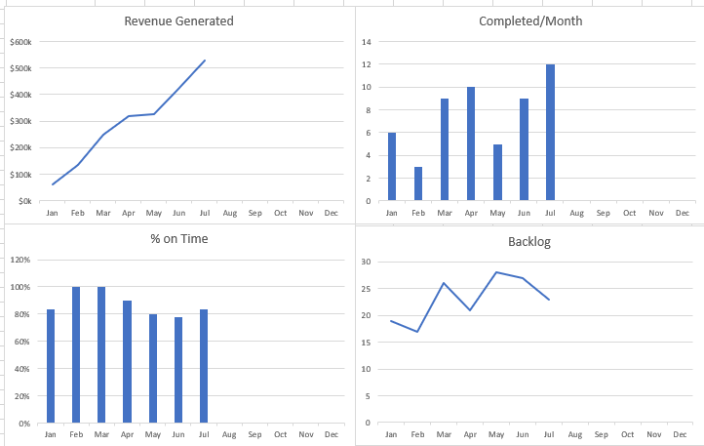

Slide 9
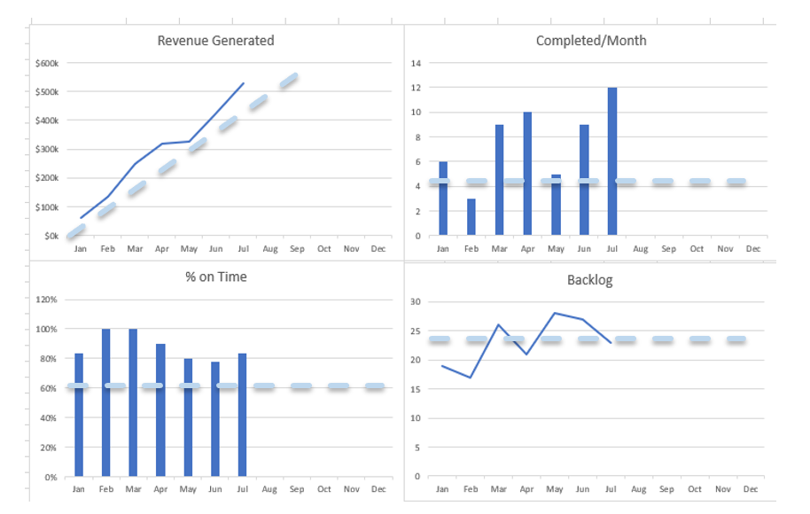

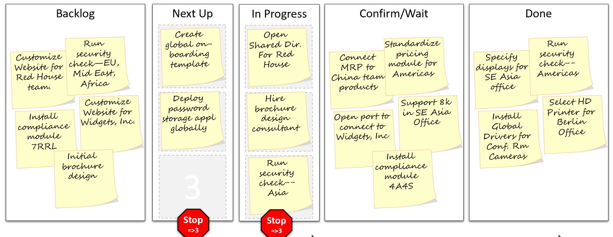
Measure Performance
Rationalize Effort
Transact
Transform

Slide 10
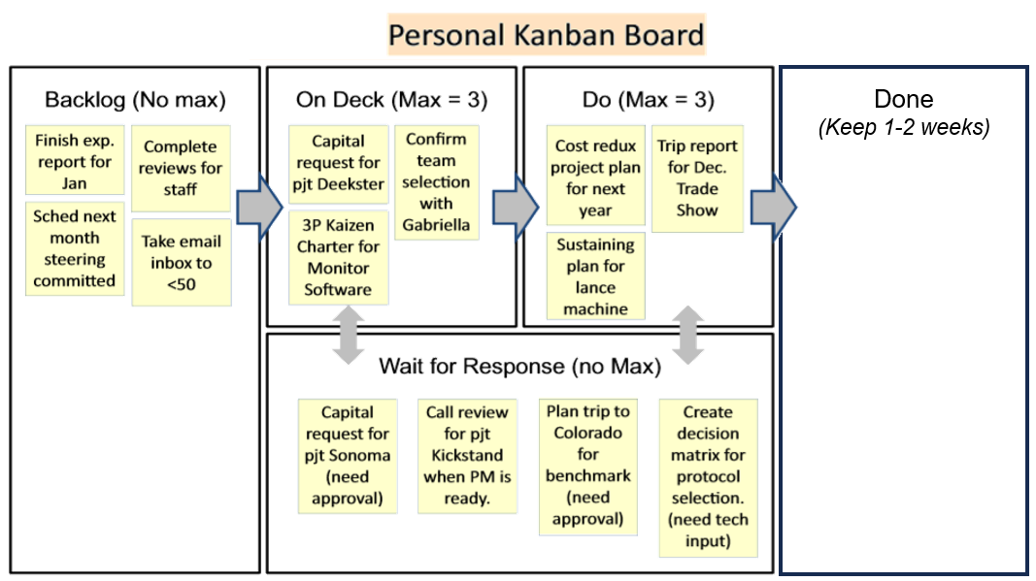

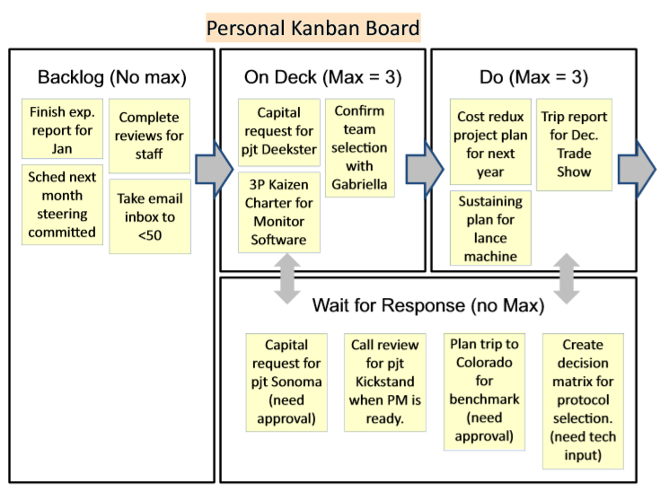
Done
(Keep 1-2 weeks)

Slide 11
Text is same on both sides
(only the color is different)
Review Project XYZZY
Card 102
Review Project XYZZY
Card 102
Front = White (Unreviewed)
Back = Gray (reviewed)

Slide 12
30” (0.7 m)
Review project Regina
Card 99
Project Review
Quarterly Kamishibai Board
Each card is
placed either white side showing (task undone) or…
White-side =
Project unreviewed
…gray side showing
(task done)
60” (1.5 m)
Review Project XYZZY
Card 102
Gray-side =
Project reviewed

Slide 13
Project Review
Quarterly Kamishibai Board
Project Review
Quarterly Kamishibai Board
Project Review
Quarterly Kamishibai Board
April 1
May 15
May 15
June 20
Shown at beginning of the quarter
(no projects reviewed)
Shown in the middle of the quarter
(about half of the projects reviewed)
Shown near the end of the quarter
(all but two projects reviewed)

Slide 14
30” (0.7 m)
Review Project XYZZY
Card 102
Legend
Project Review Kamishibai Board
Done
Not Done
Last review:
20-Jan
January
February
March
Review Project XYZZY
Card 102
Review Project
Forkanork
Card 19
Review Project
W. Abby
Card 22
Review Project XYZZY
Card 102
Review Project
Regina
Card 99
Review Project
Luce Sum
Card 9
Review Project
Spree
Card 14
Review Project Run-a-Round
Card 92
Review Project
Win-Some
Card 91
Review Project
Wassle Pop
Card 7
Step 1
Get two pads of different colored sticky notes
Step 2
Write every project name twice, once on each color sticky note
Step 3
Use a poster board or any surface that sticky notes easily adhere to, print out a few labels to guide the team, and get started.

Slide 15
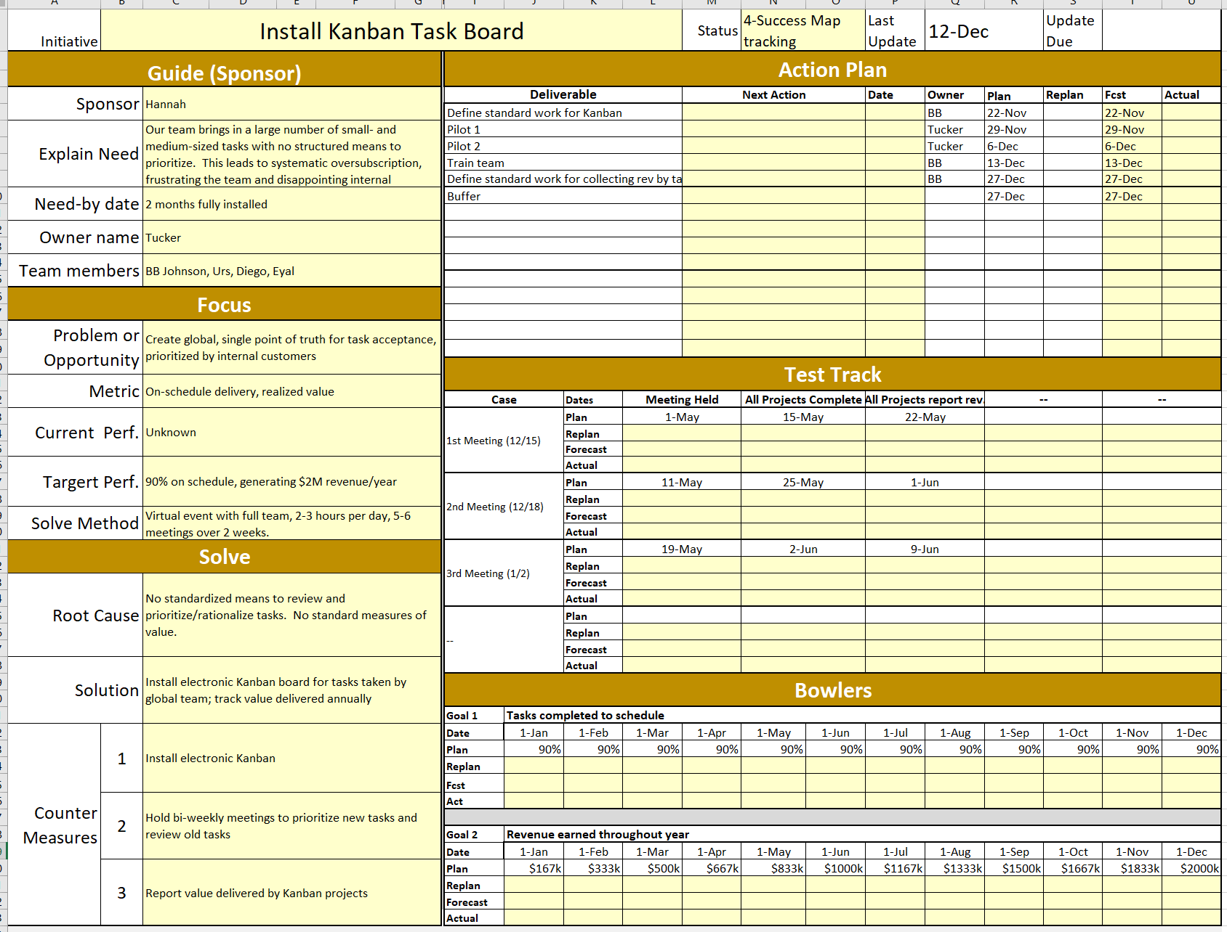

Slide 16
      There will be one way to prioritize our small projects
Our delivery and quality will delight customers
We will deliver on time almost every time
The Kanban/Kamishibai is our SPoT for decisions on small workflows
internal customers prioritize
we’ll maximize value
our dashboard
our goals
Ruthless rationalization removes ambiguity
We’ll prioritize as a team so we’ll stay aligned
We will take on only what we can do well.

